Slide 1

Eye Gaze Controlled Smart Mobile Robot
Done By:
Team: Utopia
D. Sai Tharun Reddy
Ghanshyam S Nair
Sandeep Preetham MC
Guided By:
Mr. Nippun Kumar A.A.

Slide 2
Contents:
Introduction
Literature Survey
System Process
Algorithms
Hardware Requirements
System Architecture
Implementation
Conclusion & Future Scope
References

Slide 3

Wireless intel car is designed to help the paralyzed person who moves on a car, the car will automatically move to a particular direction as the patient moves his eyes towards a direction, with the help of Eyeball movement detection camera.
The inability to control the limbs is the main reason that affects the daily activities of the disabled which causes social restrictions and isolation.
These events may result in devastating neuromuscular disorders, resulting in significant disabilities as a result of injuries to the spinal cord, which may be caused by a lack of nerve supply, paralyzing every affected part of the human body.
INTRODUCTION

Slide 4
Literature Survey:
S.No | Paper Title | Publisher | Authors | Description
1 | A Novel Cross-Ratio Based Gaze Estimation Method | 2022 | S. Fan, J. Chi and J. Liu. | The proposed a new method to approximate the pupil plane step by step through constructing the front and rear planes, and then estimate the point-of-regard based on cross-ratio invariance.
2 | Cursor Control Using Eyeball Movement | 2019 | V. Khare, S. G. Krishna and S. K. Sanisetty. | An Internet protocol camera was employed in this study to capture an image of an eye frame for cursor movement. They are employing Raspberry Pi for pupil detection, which can work with a computer cursor and even an Eye Aspect Ratio (EAR) for this task.
Notes:
In this study, the authors offer a novel approach for approximating the pupil plane by first building the front and back planes and then approximating the point-of-regard using cross-ratio invariance.
. The built-in response mechanism will activate in the event of an emergency and notify the person who needs to know..

Slide 5
Literature Survey:
S.No | Paper Title | Publisher | Authors | Description
3 | Eye Pupil Controlled Transport Riding Wheelchair | 2021 | J. M. Akanto, M. K. Islam, A. Hakim, M. A. H. Sojun and K. Shikder. | The recommend control system can welfare for paralyzed individuals to refine their existence. The hardware and software architecture has been described. To detect eye pupil location the Open computer vision (OpenCV) library has been used.
4 | Design of An Intelligent Wheelchair for Handicap People Conducting by Body Movement | 2020 | M. A. Sajid, M. Mahmud, I. Rahaman, Saquib Shahriar, Mim Naz Rahman | In this paper, a smart wheelchair topology is proposed which is operated by a hand movement device and a smartphone. It is a hand-held wheelchair in which the gyro sensor and accelerometer are used, and the Bluetooth phone control module is used to make it automatic.
Notes:
By moving their hands, users of the gesture system will be able to maneuver their wheelchair forward, backward, left, and right. the suggested wheelchair began operating with 5° less angles for forward and backward movement and 3° fewer angles for left and right movement.
The minimal threshold angle for a wheelchair powered by a microcontroller is compared in this study.

Slide 6
Literature Survey:
S.No | Paper Title | Publisher | Authors | Description
5 | Design and Development of a Smart Wheelchair for the Disabled People | 2021 | F. Ahmed, R. Paul, M. M. Ahmad, A. Ahammad and S. Singha. | In this paper, the researchers created a smart wheelchair with two different driving systems, including gesture and thumb controls.
6 | Smart wheelchair integrating head gesture navigation. | 2019 | P. Dey, M. M. Hasan, S. Mostofa and A. I. Rana. | The main ambition behind the titled project is to introduce a smart wheelchair which will be navigated with different head gestures of the user. The proposed wheelchair has been associated with exclusive features to make the movement more comfortable and convenient.
Notes:
Their suggested method's primary objective is to improve the computer experience for those with physical disabilities by helping them get past obstacles like using a mouse.
Because of the methods used, this wheelchair is equally suited for persons who wear glasses, unlike traditional wheelchairs.

Slide 7
Summary:
Instead of EAR ratio, we used Gaze ratio.
Inferring from the above paper, we have come to a solution of building an UI using Matlab.
Making use of Arduino Uno instead of Raspberry pi (to work with minimal computation and cost-efficient)
Transmission is efficient , constructive and more economic when done through a Bluetooth module from the Image processing system to the microcontroller.

Slide 8
System Process:
Camera
CPU
Bluetooth
Microcontroller
Motor Driver
DC Motor
Face Detection
Detect person face
Crop the face
Eye Detection
Detect the eye
Extract the eye
Eyeball Movement
Detect eyeball movement
Detect direction of eyeball

Slide 9
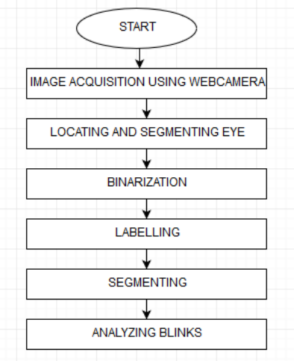
Trajectory of the project:

Slide 10
Image Processing:
Image processing basically includes the following three steps:
Importing the image with optical scanner or by digital photography.
Analyzing and manipulating the image which includes data compression and image enhancement and spotting patterns that are not to human eyes like satellite photographs.
Output is the last stage in which result can be altered image or report that is based on image analysis.

Slide 11
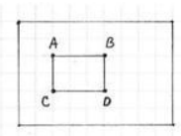
Viola-Jones algorithm:
The Viola-Jones algorithm is a widely used mechanism for object detection. The main property of this algorithm is that training is slow, but detection is fast.
This algorithm uses Haar basis feature filters, so it does not use multiplications. The efficiency of the Viola-Jones algorithm can be significantly increased by first generating the integral image.
The integral image allows integrals for the Haar extractors to be calculated by adding only four numbers. For example, the image integral of area ABCD (Figure) is calculated as
II(yA,xA) – II(yB,xB) – II(yC,xC) + II(yD,xD).

Slide 12
Viola-Jones algorithm:
Detection happens inside a detection window. A minimum and maximum window size is chosen, and for each size a sliding step size is chosen. Then the detection window is moved across the image as follows:
1. Set the minimum window size, and sliding step corresponding to that size.
2. For the chosen window size, slide the window vertically and horizontally with the same step. At each step, a set of N face recognition filters is applied. If one filter gives a positive answer, the face is detected in the current widow.
3. If the size of the window is the maximum size stop the procedure. Otherwise increase the size of the window and corresponding sliding step to the next chosen size and go to the step 2.

Slide 13
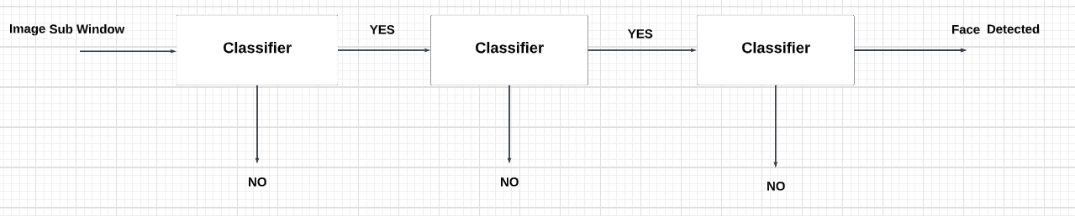
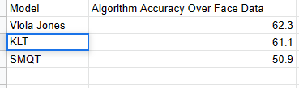
Algorithm and Analysis:
Object detection Viola-Jones algorithm
Calculated Accuracy

Slide 14
Hardware Requirements:
Processor (for image processing)
Arduino Uno (Microcontroller)
Bluetooth Module
Camera
Motor Driver
Dc Motors
Batteries

Slide 15

Arduino Uno
The Arduino Uno is a microcontroller board based on the ATmega328. It has 14 digital input/output pins (of which 6 can be used as PWM outputs), 6 analog inputs, a 16 MHz ceramic resonator, a USB connection, a power jack, an ICSP header, and a reset button.
Specifications:
Microcontroller : ATmega328
Operating Voltage : 5V
Input Voltage : 7-12V
Digital I/O Pins : 14 (of which 6 provide PWM output)
Analog Input Pins : 6
DC Current per I/O Pin: 40 mA
Flash Memory : 32 KB
SRAM : 2 KB
Clock Speed : 16 MHz

Slide 16
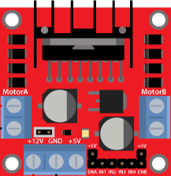
Motor Driver L298
L298 Motor Driver is a high voltage, high current dual full-bridge driver designed to accept standard TTL logic levels and drive inductive loads such as relays, solenoids, DC and stepping motors.
Two enable inputs are provided to enable or disable the device independently of the input signals. The emitters of the lower transistors of each bridge are connected together and the corresponding external terminal can be used for the connection of an external sensing resistor.
An additional supply input is provided so that the logic works at a lower voltage.

Slide 17
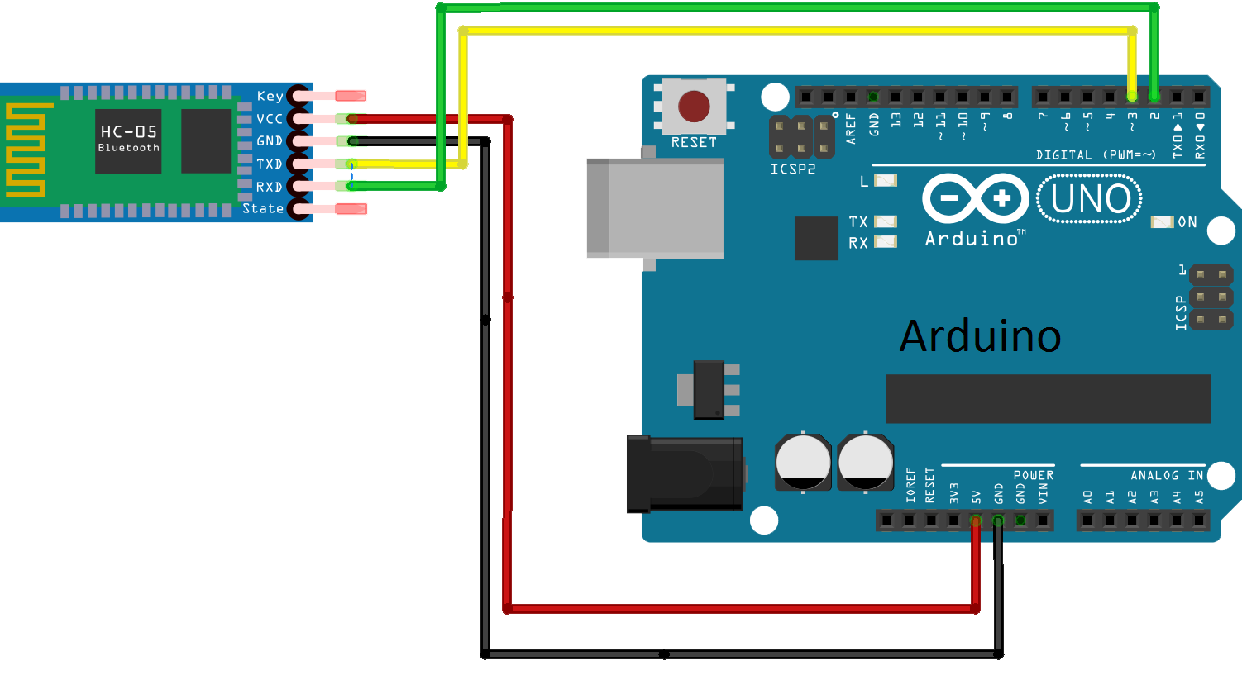
Bluetooth Module HC-05

Slide 18
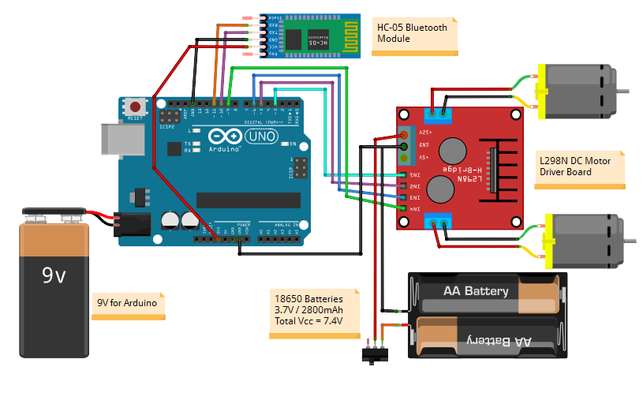
L298 & HC-05 Connected with Arduino:

Slide 19
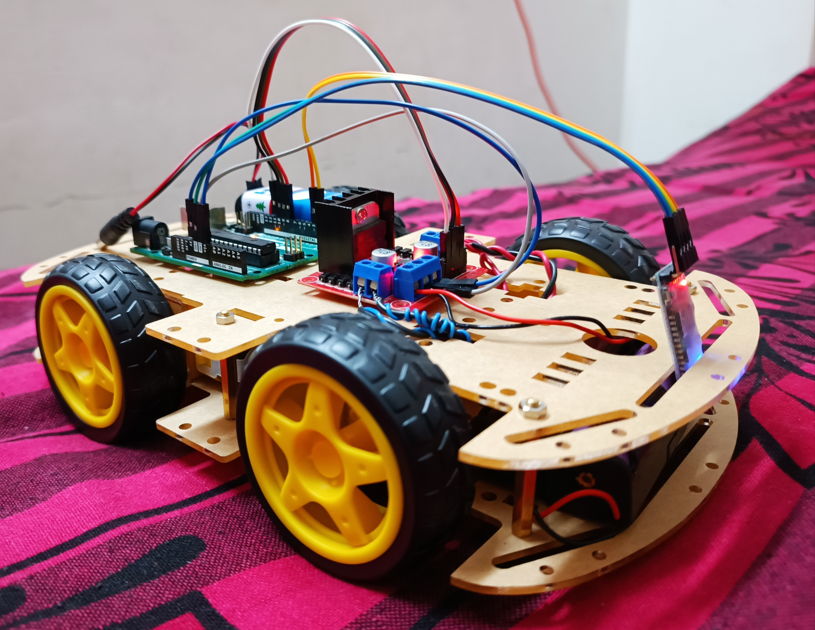
Robot Assemble And Setup:

Slide 20
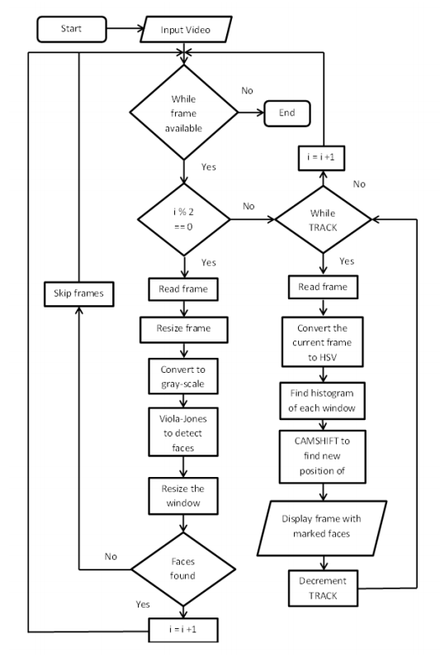
Implementation Architecture for Code:

Slide 21
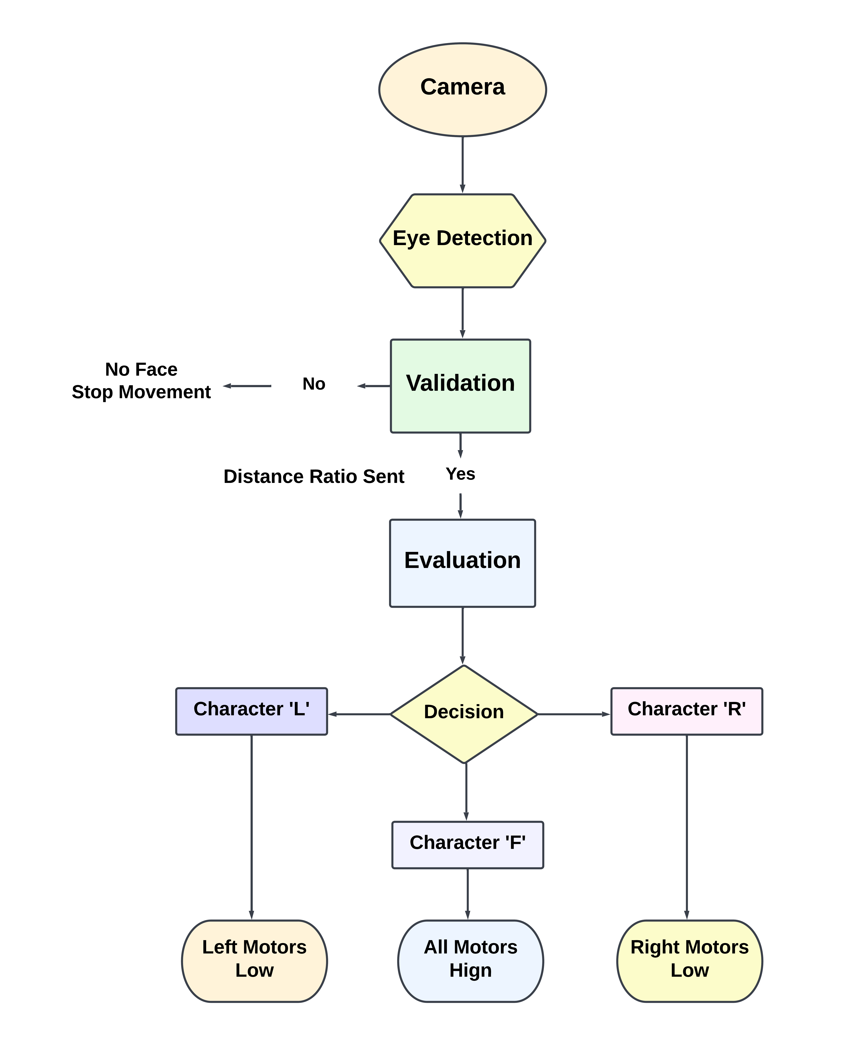
Integrated System Architecture:
The Viola-Jones algorithm is the foundation of our work. This component accepts real-time video as input and processes it by converting it into individual pictures, or frames.
Based on that the deductions are made on which direction the eye is moving the information is sent forward to the micro controller with the help of HC-05 Bluetooth module in the form of a character string .
Based on the Character received by the micro controller , corresponding voltages are supplied to the motors to make it move as the user wants.

Slide 22
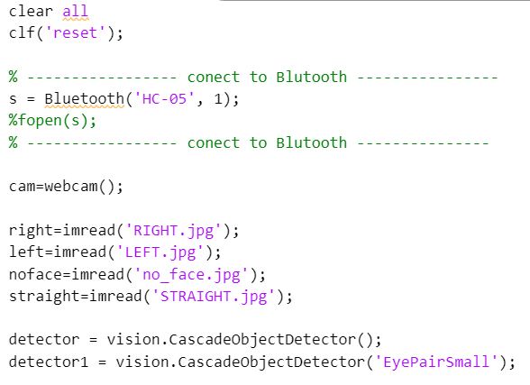
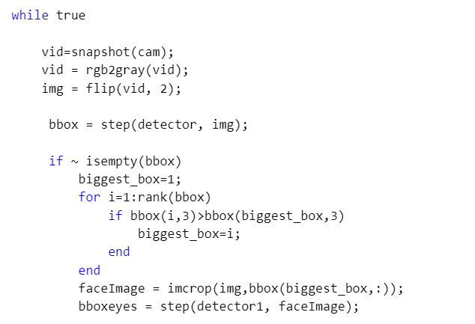
Code For Image Processing:

Slide 23
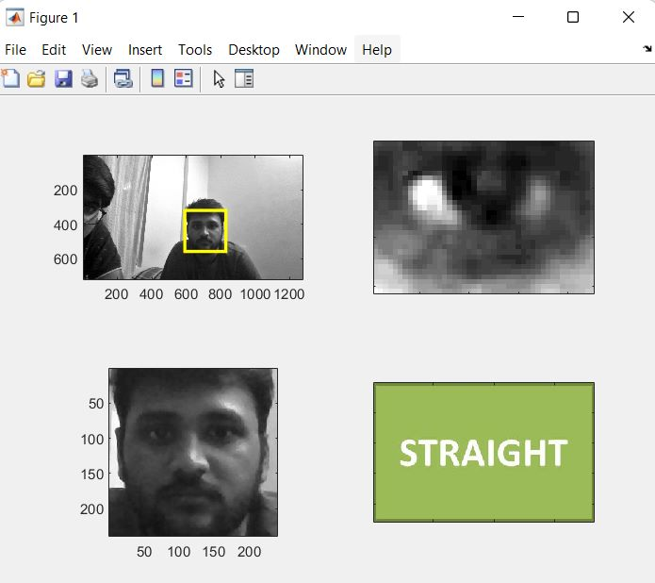
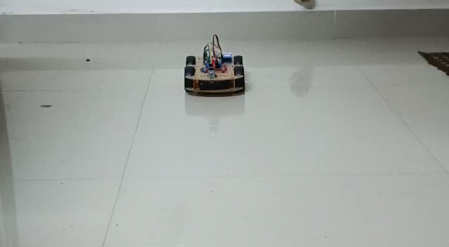
Implementation:

Slide 24
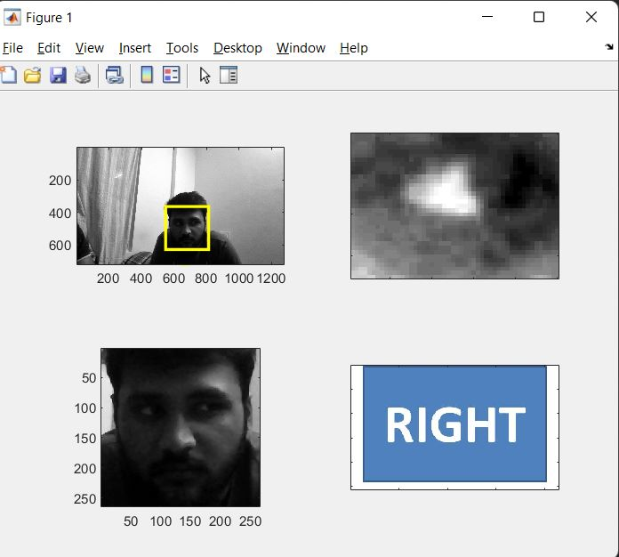
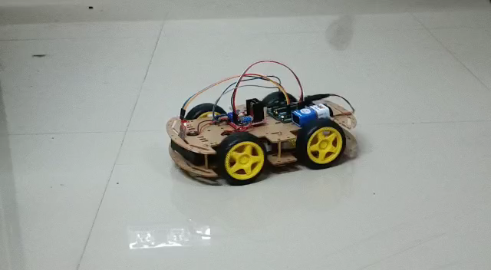
Implementation:

Slide 25
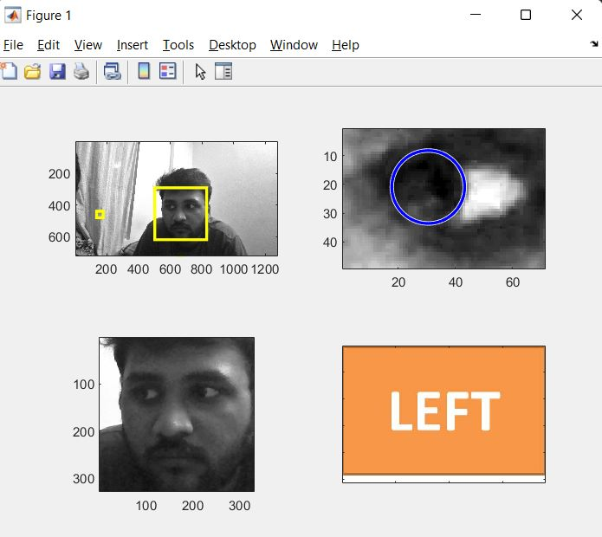
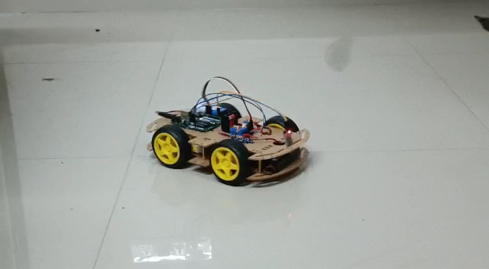
Implementation:

Slide 26
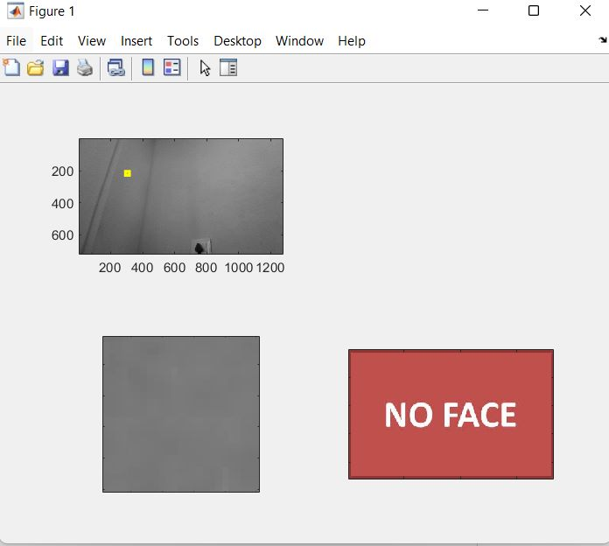
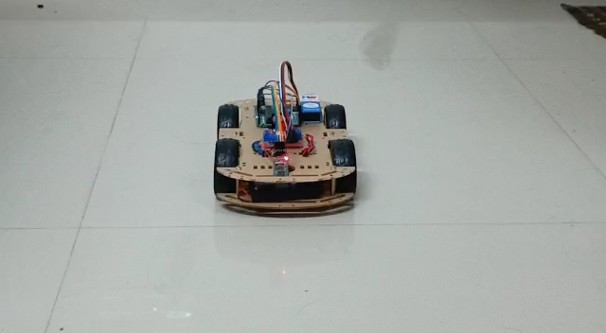
Implementation:

Slide 27
Conclusion and Future Scope :
We are successfully able to control the robot with the gaze of an eye and make movements accordingly.
This prototype can also be flexibly controlled with a remote on a smart phone.
We can add additions on the verges of sensors to improve the movement accuracy of the model.
We can host the model on a Wife- based local server method to improve its accuracy and efficiency.

Slide 28
References:
S. Fan, J. Chi and J. Liu, "A Novel Cross-Ratio Based Gaze Estimation Method," International Conference on Machine Learning and Knowledge Engineering (MLKE), 2022, pp. 181-186.
V. Khare, S. G. Krishna and S. K. Sanisetty, "Cursor Control Using Eyeball Movement," Fifth International Conference on Science Technology Engineering and Mathematics (ICONSTEM), 2019, pp. 232-235.
J. M. Akanto, M. K. Islam, A. Hakim, M. A. H. Sojun and K. Shikder, "Eye Pupil Controlled Transport Riding Wheelchair," 2nd International Conference on Robotics, Electrical and Signal Processing Techniques (ICREST), 2021, pp. 413-417.
M. A. Sajid, M. F. Mahmud, I. Rahaman, S. Shahriar and M. N. Rahman, "Design of An Intelligent Wheelchair for Handicap People Conducting by Body Movement," 11th International Conference on Computing, Communication and Networking Technologies (ICCCNT), 2020, pp. 1-5.
F. Ahmed, R. Paul, M. M. Ahmad, A. Ahammad and S. Singha, "Design and Development of a Smart Wheelchair for the Disabled People," International Conference on Information and Communication Technology for Sustainable Development (ICICT4SD), 2021, pp. 45-49.
P. Dey, M. M. Hasan, S. Mostofa and A. I. Rana, "Smart wheelchair integrating head gesture navigation," International Conference on Robotics, Electrical and Signal Processing Techniques (ICREST), 2019, pp. 329-334.

Slide 29
Thank You

